Slide 1
PFAS Chemical Exposure and cognitive function in old adults: National Nutrition and Examination Survey 2011-2014
Yi Chen
Ohio State University

Slide 2
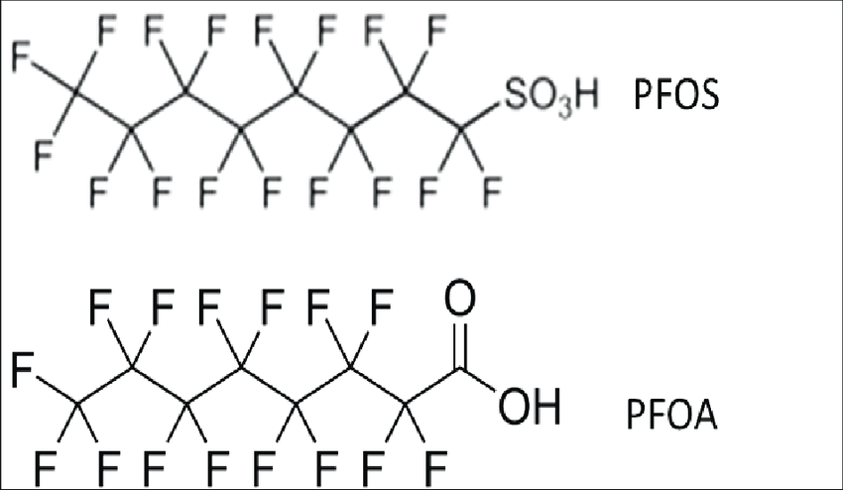
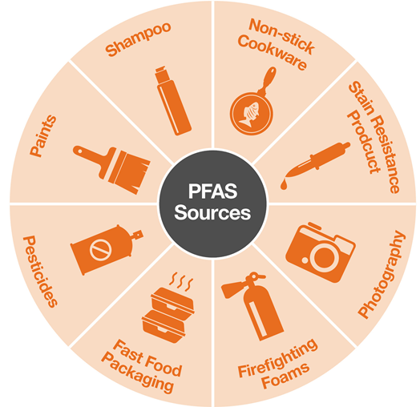
Background
Perfluoroalkyl Substances (PFAS) chemicals have been widely used since 1950s in manufacturing of non-stick coating for cookware, water and stain resistant fabrics, fast food packages, and firefighting foams.
These chemicals may be toxic to liver, kidney, and cardiovascular system.
Research on PFAS chemical exposure and adult cognitive decline and brain functionality is limited.

Slide 3
Research Question
Does exposure to PFAS chemical have a relationship with cognitive functions in old adults?

Slide 4
Data Sources
National Health and Nutrition Examination Survey 2011-2014
Nationally representative sample of US civilian population
902 adults at age 60 and above
NHANES Participants
2011-2014
n = 19,931
n = 3,632
n = 2,934
n = 902
Age less than 60 years
n = 16,299
Incomplete cognitive tests
n = 698
Without PFAS Data
n = 2,032

Slide 5
Tests for cognitive function
Consortium to Establish a Registry for Alzheimer’s Disease (CERAD)
Average of 3 score trial recalls (Word Learning sub-test)
Score Delayed Recall (Word Learning sub-test)
Animal Fluency Test
Digital Symbol Substitution Test

Slide 6
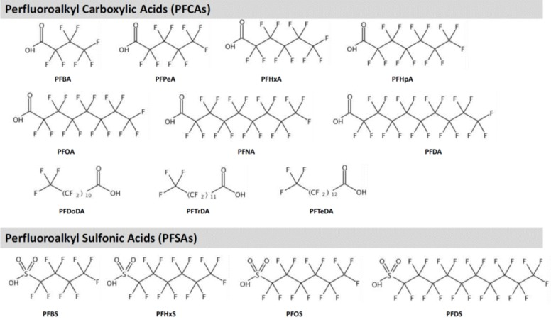
Chemicals measured in serum samples
PFOS: Perfluorooctane sulfonic acid
PFOA: Perfluorooctanoic acid
PFHS: Perfluorohexane sulfonic acid
PFNA: Perflorononanoic acid

Slide 7
Covariates adjusted
Gender
Race
Age
Education Level
Marital Status
Poverty-Income Ratio
Smoking
Alcohol
BMI
High Blood Pressure
High Cholesterol Level
Diabetes
Coronary Heart Disease
Stroke

Slide 8
Regression Analyses
R survey module to account for complex sampling methods
Regression Model
Serum PFAS concentration natural log transformed
Linear regression: Continuous outcomes of test score
Logistic regression: Binary outcomes of low cognitive function defined as less than 25th percentile of test scores
Unadjusted model
Adjusted Model 1: Adjusted for gender, race, age, education, marital status, poverty income ratio, smoking, alcohol, and BMI
Adjusted Model 2: Adjusted for all covariates in Model 1 plus high blood pressure, high cholesterol level, diabetes, coronary heart disease, and stroke

Slide 9
Variables | N | Weighted % or mean ± SE or Median (IQR)
Age | 902 | 69.4 ± 0.3
Male | 443 | 45.8
Race
Hispanic | 171 | 6.7
Non-Hispanic White | 432 | 80.7
Non-Hispanic Black | 217 | 8.0
Other | 82 | 4.6
Education
Less than high school | 247 | 18.1
High school or GED | 212 | 22.6
Some college | 246 | 32.1
College Graduate or above | 96 | 27.2
Marital status
Married | 521 | 64.1
Widowed | 184 | 18.0
Others | 195 | 17.9
Poverty income ratio
0-1.99 | 364 | 27.9
2-3.99 | 223 | 28.9
4 or more | 225 | 34.2
Missing | 90 | 9.0
Study Participant Demographics

Slide 10
Variables | N | Weighted % or mean ± SE or Median (IQR)
Smoking
Current | 118 | 10.6
Former | 358 | 41.4
Alcohol | 609 | 73.6
BMI (kg/m²)
<25 | 277 | 31.9
25-29.99 | 338 | 39.9
≥30 | 263 | 28.2
High blood pressure | 560 | 60.7
High cholesterol level | 523 | 61.7
Diabetes | 225 | 21.1
Coronary heart disease | 76 | 9.8
Stroke | 52 | 4.4
Lifestyle, BMI, and medical conditions

Slide 11
Variables | N | mean ± SE or Median (IQR)
Serum PFAS Concentrations (ng/mL)
PFOS | 902 | 9.3 (5.6-14.1)
PFOA | 902 | 2.7 (1.9-3.7)
PFHxS | 902 | 1.9 (1.1-2.9)
PFNA | 902 | 0.9 (0.7-1.4)
Cognitive Function Scores
Mean CERAD score trials recall | 902 | 6.5 ± 0.1
CERAD score delayed recall | 902 | 6.3 ± 0.1
Animal Fluency Score Total | 902 | 18.0 ± 0.3
Digital Symbol Score | 902 | 52.3 ± 0.9
Serum PFAS concentrations and cognitive function scores

Slide 12
Linear Regression Results
Regression estimates and 95% confidence intervals

Slide 13

PFAS | Mean CERAD Score Trials Recall | CERAD Score Delayed Recall | Animal Fluency Score Total | Digital Symbol Score
Unadjusted
PFOS | -0.12 (-0.22, -0.02) | -0.15 (-0.33, 0.03) | -0.29 (-0.77, 0.19) | -1.44 (-2.90, 0.02)
PFOA | 0.24 (0.02, 0.46) | 0.37 (0.01, 0.72) | 0.59 (-0.38, 1.55) | 2.60 (-0.03, 5.22)
PFHxS | 0.08 (-0.11, 0.28) | 0.10 (-0.20, 0.40) | 0.11 (-0.45, 0.67) | 1.04 (-1.02, 3.09)
PFNA | 0.08 (-0.11, 0.28) | 0.33 (0.07, 0.60) | 0.64 (-0.14, 1.42) | 1.70 (-0.07, 3.46)
Adjusted Model 1
PFOS | -0.04 (-0.93, 0.84) | -0.03 (-0.22, 0.15) | -0.24 (-0.68, 0.20) | -0.44 (-1.67, 0.78)
PFOA | 0.18 (-0.01, 0.38) | 0.28 (-0.02, 0.59) | 0.28 (-0.54, 1.10) | 0.97 (-0.80, 2.74)
PFHxS | 0.10 (-0.04, 0.25) | 0.13 (-0.09, 0.35) | -0.11 (-0.53, 0.31) | 0.71 (-0.63, 2.04)
PFNA | 0.17 (0.01, 0.33) | 0.25 (0.01, 0.49) | 0.47 (-0.20, 1.13) | 0.23 (-1.24, 1.69)
Adjusted Model 2
PFOS | -0.06 (-0.19, 0.07) | -0.04 (-0.23, 0.15) | -0.29 (-0.72, 0.14) | -0.56 (-1.79, 0.66)
PFOA | 0.16 (-0.02, 0.35) | 0.29 (-0.01, 0.59) | 0.20 (-0.61, 1.00) | 0.76 (-1.06, 2.58)
PFHxS | 0.09 (-0.06, 0.23) | 0.14 (-0.07, 0.35) | -0.13 (-0.57, 0.31) | 0.84 (-0.57, 2.25)
PFNA | 0.13 (-0.02, 0.29) | 0.23 (-0.01, 0.47) | 0.32 (-0.33, 0.97) | -0.01 (-1.39, 1.38)

Slide 14
Logistic Regression Results
Odds Ratios and 95% confidence intervals

Slide 15
PFAS | Low CERAD Score Trials Recall (< 5.3) | Low CERAD Score Delayed Recall (<5) | Low Animal Fluency Score Total (<13) | Low Digital Symbol Score (<34) | Low Digital Symbol Score (<34)
Percent | 16.6 | 19.4 | 15.7 | 13.6 | 13.6
Unadjusted
PFOS | 1.09 (0.85, 1.39) | 1.17 (0.91, 1.51) | 0.90 (0.67, 1.22) | 0.89 (0.75, 1.07) | 0.89 (0.75, 1.07)
PFOA | 0.58 (0.43, 0.80) | 0.65 (0.44, 0.96) | 0.60 (0.43, 0.84) | 0.56 (0.41, 0.78) | 0.56 (0.41, 0.78)
PFHxS | 0.77 (0.57, 1.04) | 0.93 (0.64, 1.35) | 0.80 (0.60, 1.05) | 0.75 (0.57, 0.99) | 0.75 (0.57, 0.99)
PFNA | 0.69 (0.53, 0.89) | 0.67 (0.49, 0.92) | 0.77 (0.56, 1.06) | 0.64 (0.51, 0.81) | 0.64 (0.51, 0.81)
Adjusted Model 1
PFOS | 0.99 (0.73, 1.34) | 1.08 (0.83, 1.41) | 0.90 (0.68, 1.19) | 0.82 (0.62, 1.08)
PFOA | 0.54 (0.36, 0.82) | 0.67 (0.43, 1.05) | 0.70 (0.51, 0.96) | 0.67 (0.42, 1.06)
PFHxS | 0.72 (0.52, 0.99) | 0.91 (0.64, 1.30) | 0.86 (0.67, 1.09) | 0.84 (0.61, 1.16)
PFNA | 0.70 (0.50, 0.99) | 0.71 (0.48, 1.05) | 0.85 (0.61, 1.19) | 0.72 (0.49, 1.05)
Adjusted Model 2
PFOS | 1.02 (0.76, 1.37) | 1.09 (0.84, 1.41) | 0.92 (0.69, 1.23) | 0.85 (0.64, 1.12)
PFOA | 0.54 (0.36, 0.83) | 0.67 (0.43, 1.03) | 0.73 (0.52, 1.01) | 0.68 (0.43, 1.08)
PFHxS | 0.74 (0.54, 1.02) | 0.92 (0.65, 1.29) | 0.88 (0.69, 1.13) | 0.84 (0.61, 1.14)
PFNA | 0.73 (0.52, 1.02) | 0.71 (0.49, 1.03) | 0.92 (0.64, 1.33) | 0.75 (0.51, 1.11)

Slide 16
Discussion
We did not observe an adverse association between PFAS exposure and cognitive function in old adults.
However, this analysis is cross-sectional and cannot examine cause and effect association.
Most protective associations we observed in adjusted model 1 did not persist in adjusted model 2.

Slide 17
Strengths and Limitations
Strengths
Using data from a nationally representative population
Addressing a data gap of PFAS exposure and cognitive function in older adults
Adjusting for other factors that may confound the association
Limitations
Limited testing of cognitive functions
Not considering other chemical exposures
Not a prospective study

Slide 18
Conclusion
In the NHANES 2011-2014, we did not find adverse effects of PFAS exposure on adult cognitive functions.
More research is needed in a prospective cohort study to examine PFAS exposure and other chemicals related to cognitive functions.

